Slide 1




ALL ABOUT ME..!
VYOM KORAT
Notes:
1.7.2013
1.7.2013
1
‹#›
‹#›

Slide 2

I am …
I'm a Hard Worker
While I may be a bit lazy at times, I'm always striving to overcome my weaknesses and become the best version of myself.
I Analyze Everything
i am overthinker and analyzing any more things.
I Believe in Kindness
I'm a good person who values kindness, honesty, and compassion. I try to treat everyone I meet with respect.
I'm Emotional
i am emotional so i can't see anyone crying.
I'm Passionate About Tech
Data analytics is my jam - I'm always eager to dive into the latest trends and technologies in this field.
I'm a Forgetful Soul
My memory may not be the best, but I try always remember everything.
I'm a Little mischief
but not intended to cause serious harm.
Notes:
1.7.2013
1.7.2013
2
‹#›
‹#›

Slide 3






I Love …
Gaming
Traveling
Netflix
Indoor, outdoor, and mobile games.
Exploring new places and cultures.
Enjoying movies and TV series.
Nature
spending time
Appreciating the beauty of the outdoors.
friends,family and also alone
Notes:
1.7.2013
1.7.2013
3
‹#›
‹#›

Slide 4
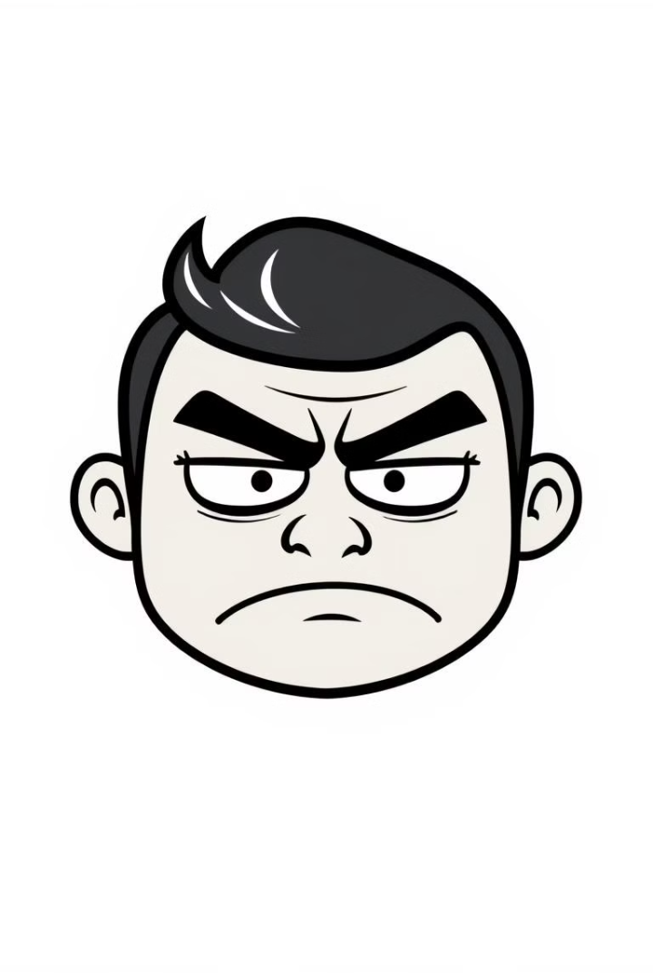

I hate …
1
Vegetables
i don't like eat anyone vegetables.
2
Repetition
I dislike being told the same thing repeatedly. It quickly makes me frustrated.
3
Unreliability
Dislike flaky and inconsistent people.
4
Dishonesty
Strong dislike for liars.
5
Lack of Consistency
I hate that sometimes I struggle with being consistent, and it makes me feel disappointed in myself.
Notes:
1.7.2013
1.7.2013
4
‹#›
‹#›

Slide 5










I Beliefs …
Hard work
Karma
Dedication leads to success.
What goes around comes around.
Luck
Chance plays a role.
God
Trust in a higher power.
positivity
I believe in staying positive.
Notes:
1.7.2013
1.7.2013
5
‹#›
‹#›

Slide 6
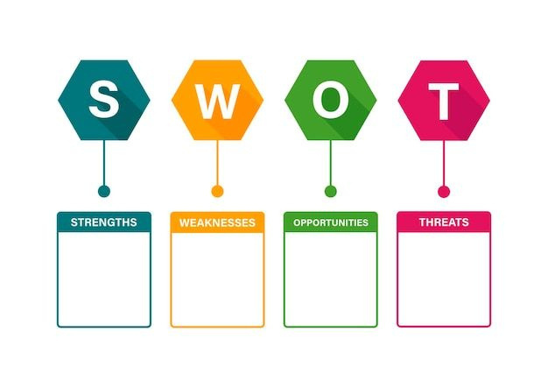
Open minded
Responsible
Empathy
Focused
Family&Freinds
support
Multitasking
Time management
Overthinking
Money management
Easily nervous
Networking
Freelancing
Explore IT industria
Competition
AI
Distractions
Notes:
1.7.2013
1.7.2013
6
‹#›
‹#›

Slide 7




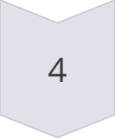

Purpose
Family Happiness
Ensuring my family's well-being.
Financial Stability
Achieving financial security.
Live Happy
Leading a joyful life.
Feel Proud
My family is proud of me.
Healthy life
Balance is Key
Notes:
1.7.2013
1.7.2013
7
‹#›
‹#›

Slide 8

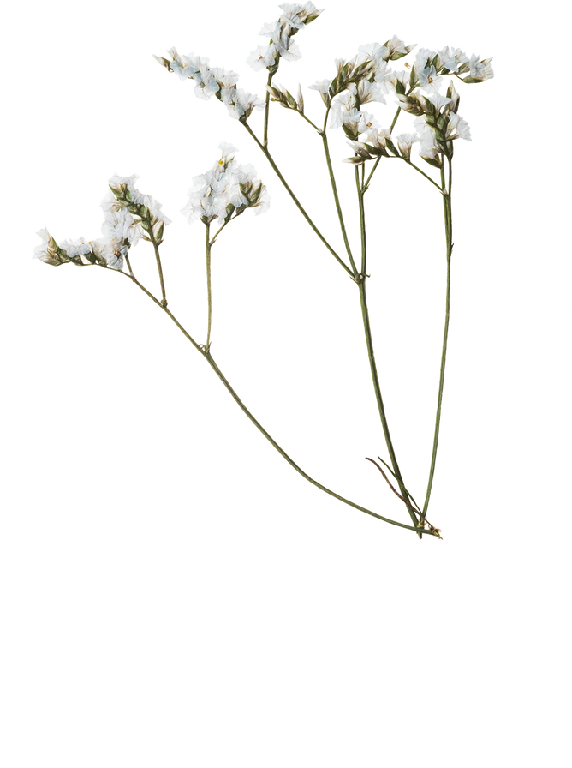
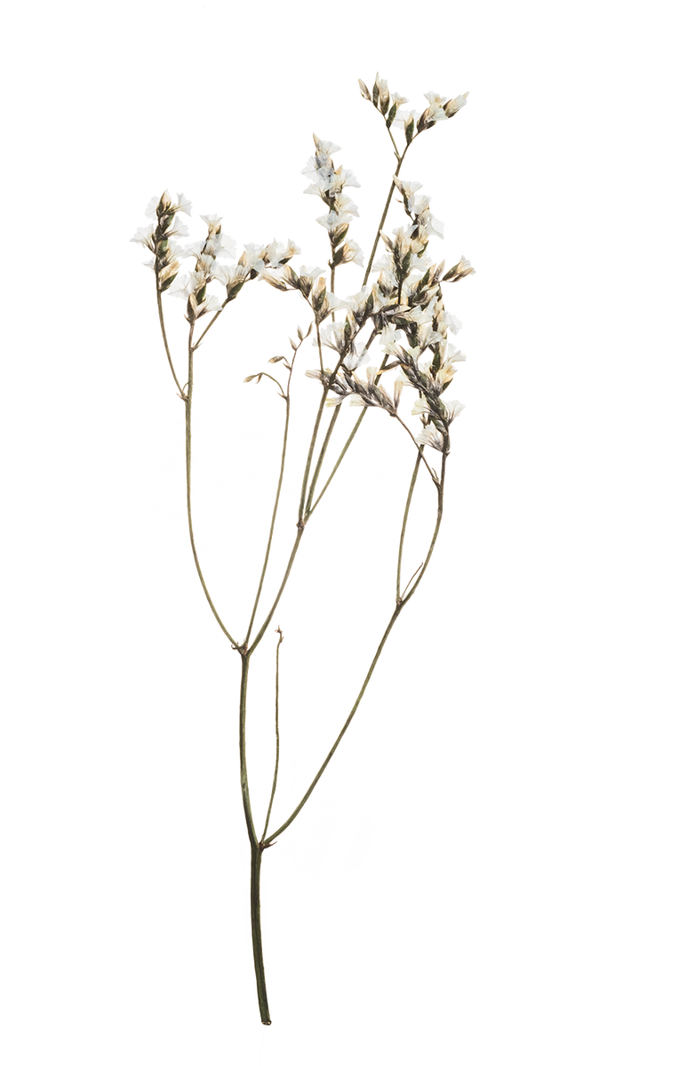
thank you

